Slide 1
Microsoft Azure Fundamentals

Slide 2
Tissana Tanaklang
Software Development Trainer Iverson Training Center Co., Ltd.
tissana@iverson.co.th
Microsoft Certified Trainer (MCT)
Microsoft Certified Solutions Associate (MCSA) - Web Application Development
Microsoft Certified Azure Fundamentals
Microsoft Certified Professional (MCP)

Slide 3
Agenda
Time | December 12th
9:0 – 9:15 | Azure Fundamentals - Introduction
9:15 | Azure Fundamentals – Module 1 Understanding cloud concepts
10:15
10:15 | Break – 30 minutes
10:45 | Azure Fundamentals – Module 2 Understanding core Azure services
11:30
11:30 | Lunch – 60 minutes
12:30
12:30 | Azure Fundamentals – Module 3 Understand security, privacy, compliance, and trust
1:30
1:30 -2:00 | Break – 30 minutes
2:00 | Azure Fundamentals – Module 4 Understand Azure pricing and support
3:30
3:30 | Wrap up / Feedback
4:00

Slide 4
Description
Azure Fundamentals introduces cloud services, and how these services are provided by Microsoft Azure. Take this course as a first step towards learning about cloud computing and Azure, before taking further courses.
This course covers:
General cloud computing concepts, models, and services such as:
Public, Private, and Hybrid clouds
Infrastructure, Platform, and Software as a Service
Core Azure products, services and tools for security, privacy, compliance, and trust
Azure pricing and support options

Slide 5
Audience
Azure Fundamentals is suitable for candidates from technical and non-technical backgrounds, whose current or future work relates to cloud computing.
For example, those who are involved in selling or purchasing cloud-based products, solutions and services, or those taking their first look at cloud computing and Azure

Slide 6
Prerequisites
There are no prerequisites for taking this course. Technical IT experience is not required; however, some general IT knowledge or experience is beneficial.

Slide 7
Certification areas (AZ-900)
Study areas | Weights
Understanding cloud concepts | 15-20%
Understanding core Azure services | 30-35%
Understand security, privacy, compliance, and trust | 25-30%
Understand Azure pricing and support | 25-30%
This course maps directly to the exam AZ-900 Microsoft Azure Fundamentals
Percentages indicate the relative weight of each area on the exam.
The higher the percentage, the more questions you are likely to see in that area.
Notes:
AZ-900 Certification Areas - https://www.microsoft.com/en-us/learning/exam-az-900.aspx

Slide 8

Hands-On Components
No labs or group structured hands on components in this course.
Recorded demos, and step by step walkthroughs available throughout the course, and we would encourage you to follow, or attempt, some, or all, of these as you see fit.
A free Microsoft Azure account is recommended. For help, see:
Create your free account today: azure.microsoft.com/free
Create a free Azure Account - Video Demo: youtu.be/H53yVpKB3_c
Notes:
MCTs have the discretion at what point in the course they wish for students to find and try out some Azure services. However it would be recommended to have them create a free Azure account at this point for use during the course. MCTs can perform demos, use recorded demos, have students complete specific tasks, perhaps perform some group work, or alternatively students may drop in and out of Azure during the course at their own discretion exploring areas as they go.
Having the discretion around the amount and occurrences of hands on time for students, should assist the MCT in delivering the course in the allotted time, and also allow MCTs to tailor the course for specific audiences in specific areas of interest.
There are recorded demos at the locations below. Recorded demos can be used alongside or in lieu of completing the walkthroughs, or used for exam preparation for students
Demos:
Mod 0 >M00-Course Introduction\L01-Course overview\03-Demo-Create Free Azure Account
Mod 2 >M02-Core Azure Services\L03-Core Azure Services and Products\03-Demo-Create Azure Virtual machine.
Mod 2 >M02-Core Azure Services\L03-Core Azure Services and Products\05-Demo-Deploy Azure Container Instances (ACI) in Azure Portal
Mod 2 >M02-Core Azure Services\L03-Core Azure Services and Products\12-Demo-Create Blob Storage
Mod 2 >M02-Core Azure Services\L04-Azure Solutions\03-Demo-Add IoT device to Azure IoT Hub
Mod 2 >M02-Core Azure Services\L04-Azure Solutions\11-Demo-Run serverless code with Azure Functions in Azure portal
Mod 2 >M02-Core Azure Services\L05-Azure Management Tools\03-Demo-Customize the Azure Portal
Mod 2 >M02-Core Azure Services\L05-Azure Management Tools\05-Demo-Create VMs from a script with Azure PowerShell
Mod 2 >M02-Core Azure Services\L05-Azure Management Tools\07-Demo-Install IIS webserver on a VM with Azure Cloud Shell.md
Mod 2 >M02-Core Azure Services\L05-Azure Management Tools\10-Demo-Save a recommendations report with Azure Advisor
Mod 4 >M04-Azure Pricing and Support\L03-Planning and Managing costs\09-Demo-Generate an Azure Pricing Calculator estimate
Mod 4 >M04-Azure Pricing and Support\L03-Planning and Managing costs\12-Demo-Generate an Azure TCO Calculator cost comparison report
There are also walkthroughs available for MCTs to follow and use as live demos in class, or have students complete during, or after, the class.
Walkthroughs:
Mod 2 >M02-Core Azure Services\L03-Core Azure Services and Products\04-Walkthrough-Create a Virtual machine using Azure Portal
Mod 2 >M02-Core Azure Services\L03-Core Azure Services and Products\06-Walkthrough-Deploy Azure Container Instances (ACI) in Azure Portal
Mod 2 >M02-Core Azure Services\L03-Core Azure Services and Products\09-Walkthrough-Create a virtual network via the Azure Portal
Mod 2 >M02-Core Azure Services\L03-Core Azure Services and Products\13-Walkthrough-Create Blob storage
Mod 2 >M02-Core Azure Services\L03-Core Azure Services and Products\16-Walkthrough-Create a SQL database
Mod 2 >M02-Core Azure Services\L04-Azure Solutions\04-Walkthrough-Add IoT device to Azure IoT Hub
Mod 2 >M02-Core Azure Services\L04-Azure Solutions\12-Walkthrough-Run serverless code with Azure Functions in Azure portal
Mod 2 >M02-Core Azure Services\L05-Azure Management Tools\04-Walkthrough-Working with the Azure CLI
Mod 2 >M02-Core Azure Services\L05-Azure Management Tools\06-Walkthrough-Create VMs from a script with Azure PowerShell
Mod 2 >M02-Core Azure Services\L05-Azure Management Tools\07-Walkthrough-Install IIS webserver on a VM with Azure Cloud Shell
Mod 2 >M02-Core Azure Services\L05-Azure Management Tools\11-Walkthrough-Save a recommendations report with Azure Advisor
Mod 3 > M03-Security, Privacy, Compliance and Trust\L02-Securing network connectivity in Azure\03-Walkthrough-Implement an Azure Firewall using Azure Portal
Mod 3 > M03-Security, Privacy, Compliance and Trust\L02-Securing network connectivity in Azure\07-Walkthrough-Secure Network traffic using NSGs and ASGs
Mod 3 > M03-Security, Privacy, Compliance and Trust\L04-Security Tools and Features\04-Walkthrough-Implement Azure Security Center
Mod 3 > M03-Security, Privacy, Compliance and Trust\L04-Security Tools and Features\07-Walkthrough-Create Password secret with Azure Key Vault
Mod 3 > M03-Security, Privacy, Compliance and Trust\L05-Azure Governance methodologies\05-Walkthrough-Create a policy assignment with Azure Policy
Mod 3 > M03-Security, Privacy, Compliance and Trust\L05-Azure Governance methodologies\07-Walkthrough-Manage access to Azure resources using RBAC
Mod 3 > M03-Security, Privacy, Compliance and Trust\L05-Azure Governance methodologies\09-Walkthrough-Manage Azure resources using Locks
Mod 3 > M03-Security, Privacy, Compliance and Trust\L06-Monitoring and Reporting in Azure\02-Walkthrough-Use Tags with Azure resources
Mod 3 > M03-Security, Privacy, Compliance and Trust\L06-Monitoring and Reporting in Azure\05-Walkthrough-Monitor VMs using Azure Monitor
Mod 3 > M03-Security, Privacy, Compliance and Trust\L07-Privacy, Compliance and Data Protection standards in Azure\10-Walkthrough-Accessing Trust Center STP and Compliance Manager
Mod 4-Azure Pricing and Support\L02-Azure Subscriptions\06-Walkthrough-Manage Subscriptions and Management groups
Mod 4-Azure Pricing and Support\L03-Planning and Managing costs\10-Walkthrough-Generate an Azure Pricing Calculator estimate
Mod 4-Azure Pricing and Support\L03-Planning and Managing costs\13-Walkthrough-Generate an Azure TCO Calculator cost comparison report
Mod 4-Azure Pricing and Support\L04-Support Options Available with Azure\06-Walkthrough-Open a Support Request
Mod 4-Azure Pricing and Support\L05-Azure Service Level Agreements (SLAs)\05-Walkthrough-Calculate Composite SLA for an Application
Mod 4-Azure Pricing and Support\L06-Service Lifecycle in Azure\08-Walkthrough-Access Azure Preview features

Slide 9
Module 01: Cloud concepts

Slide 10
Key concepts and terms
Cloud services have certain characteristics and considerations, such as:
High availability | Disaster recovery
Scalability | Global reach
Elasticity | Customer latency capabilities
Agility | Predictive cost considerations
Fault tolerance | Security
Notes:
Provide descriptions of each characteristic.
For more conceptual detail about cloud computing, open https://azure.microsoft.com/en-us/overview/what-is-cloud-computing/
There is also a term reference guide available at https://azure.microsoft.com/en-us/overview/cloud-computing-dictionary/

Slide 11
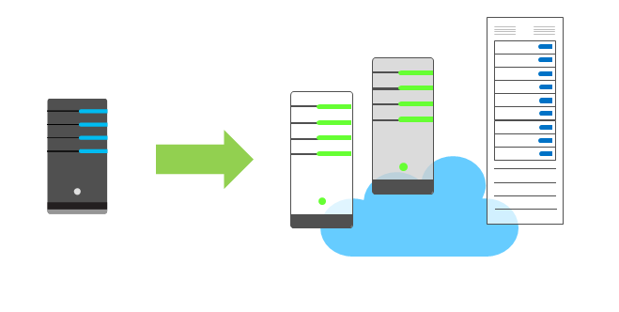
Economies of scale
The concept of economies of scale is the ability to do things less expensively and more efficiently when operating at a larger scale in comparison to operating at a smaller scale.
Cloud providers such as Microsoft, Google, and Amazon Web Services (AWS) are very large businesses, and thus can leverage the benefits of economies of scale and then pass those benefits on to their customers.
Notes:
Economies of scale are apparent to end users in a number of ways, one of which is the ability to acquire hardware at a lower cost than if a single user or smaller business were purchasing it.
Storage costs, for example, have decreased significantly over the last decade due in part to cloud providers' ability to purchase larger amounts of storage at significant discounts. They are then able to use that storage more efficiently, and pass on those benefits to end users in the form of lower prices.
However, there are limits to the benefits large organizations can realize through economies of scale. A product will inevitably have an underlying core cost as it becomes more of a commodity, based on what it costs to produce. Competition is also another factor which has an effect on costs of cloud services.

Slide 12
CapEx vs. OpEx
Capital Expenditure (CapEx) : spend on physical infrastructure up front, deduct the expense from your tax bill.
High upfront cost, value of investment reduces over time.
Operational Expenditure (OpEx) : spend on services or products as needed, and get billed immediately. Deduct the expense from your tax bill in the same year.
No upfront cost, pay-as-you use.
Notes:
Today, organizations can sign up for a service from a cloud provider to get up and running. This enables them to begin selling or providing services to their customers more quickly, without the need for significant upfront costs
If your service is busy and you consume a lot of resources in a month, then you receive a large bill. If those services are minimal and don't use a lot of resources, then you will receive a smaller bill.
A business can still use the CapEx expenditure strategy if they want, but it is no longer a requirement that they do so.

Slide 13
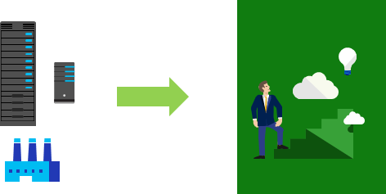
Consumption-based model
Users only pay for the resources they use
Notes:
The graphic represents physical infrastructure, which would have an associated cost to acquire it. The arrow indicates a transition to the cloud where there is no physical infrastructure. The user shows progression with their idea in the cloud, consuming only the resources that they need.
This consumption-based model brings with it many benefits, including:
No upfront costs
No need to purchase and manage costly infrastructure that they may or may not use to its fullest
The ability to pay for additional resources if and when they are needed
The ability to stop paying for resources that are no longer needed

Slide 14
Types of cloud models

Slide 15
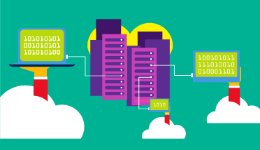
Public cloud
Owned by cloud services or hosting provider.
Provides resources and services to multiple organizations and users.
Accessed via secure network connection (typically over the internet).
Notes:
Public cloud models have the following characteristics:
Multiple end users. Public cloud modes may make their resources available to multiple organizations.
Public access. Public clouds provide access to the public.
Availability. This is the most common cloud-type deployment model.
Connectivity. Users and organizations are typically connected to the public cloud over the internet using a web browser.
Skills. Public clouds do not require deep technical knowledge to set up and use
Businesses can use multiple public cloud service provider companies of varying scale. Microsoft Azure is an example of a public cloud provider.

Slide 16
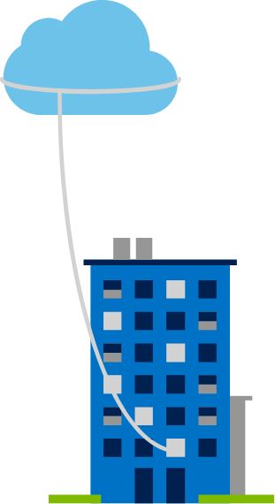
Private cloud
Owned and operated by the organization that uses cloud resources.
Organizations create a cloud environment in their data center.
Self-service access to compute resources provided to users within the organization.
Organizations responsible for operating the services they provide.
Notes:
Private cloud models have the following characteristics:
Ownership. The owner and user of the cloud services are the same.
Hardware. The owner is entirely responsible for the purchase, maintenance, and management of the cloud hardware.
Users. A private cloud operates only within one organization and cloud computing resources are used exclusively by a single business or organization.
Connectivity. A connection to a private cloud is typically made over a private network that is highly secure.
Public access. A private cloud does not provide access to the public.
Skills. Deep technical knowledge is required to set up, manage, and maintain the private cloud.

Slide 17
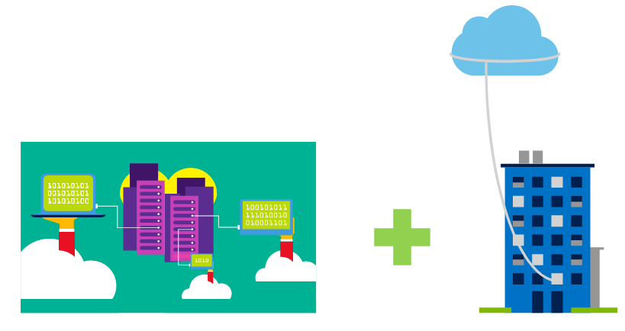
Hybrid cloud
Combines Public and Private clouds to allow applications to run in the most appropriate location.
Notes:
Hybrid cloud models have the following characteristics:
Resource location. Specific resources run or are used in a public cloud, and others run or are used in a private cloud.
Cost and efficiency. Hybrid cloud models allow an organization to leverage some of the benefits of cost, efficiency, and scale that are available with a public cloud model.
Control. Organizations retain management control in private clouds.
Skills. Technical skills are still required to maintain the private cloud and ensure both cloud models can operate together.
An example of a hybrid cloud usage scenario would be hosting a website in the public cloud and linking it to a highly secure database hosted in a private cloud.
Hybrid cloud scenarios can be useful when organizations have some information that cannot be put in a public cloud, possibly for legal reasons. For example, you may have medical data that cannot be exposed publicly.
You can read more about Microsoft Azure Hybrid cloud options at https://azure.microsoft.com/en-us/overview/hybrid-cloud/

Slide 18
Cloud model comparison
Public cloud:
No CapEx. You don’t have to buy a new server to scale up.
Agility. Applications can be made accessible quickly, and deprovisioned whenever needed.
Consumption-based model. Organizations pay only for what they use and operate under an OpEx model.
Private cloud:
Control. Organizations have complete control over resources.
Security. Organizations have complete control over security.
Hybrid cloud:
Flexibility. The most flexible scenario. With a hybrid cloud setup, an organization can determine whether to run their applications in a private cloud or in a public cloud.
Compliance. Organizations maintain the ability to comply with strict security, compliance, or legal requirements as needed.
Notes:
The slide contains only some cloud comparison discussion points. Depending on time, you may want to consider broadening out the discussion and asking for more comparison details, some answers may include
Public cloud:
Skills. No deep technical skills are required to deploy, use, and gain the benefits of a public cloud. Organizations can leverage the skills and expertise of the cloud provider to ensure workloads are secure, safe, and highly available
Skills. Private clouds requires in-house IT skills and expertise that may be hard to get or be costly
Specific scenarios. If organizations have a unique business requirement, such as having to maintain a legacy application, it may be hard to meet that requirement with public cloud services.
Costs. Purchasing and maintaining a private cloud to use alongside the public cloud can be more expensive than selecting a single deployment model.

Slide 19
Types of cloud services

Slide 20
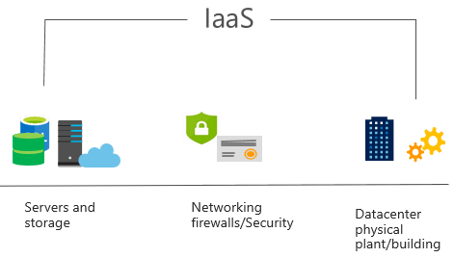
Infrastructure as a Service (IaaS)
Most basic cloud computing services category.
Build pay-as-you-go IT infrastructure by renting servers, virtual machines, storage, networks, and operating systems from a cloud provider.
Instant computing infrastructure, provisioned and managed over the internet.
Notes:
For more information on IaaS, visit https://azure.microsoft.com/en-us/overview/what-is-iaas/

Slide 21
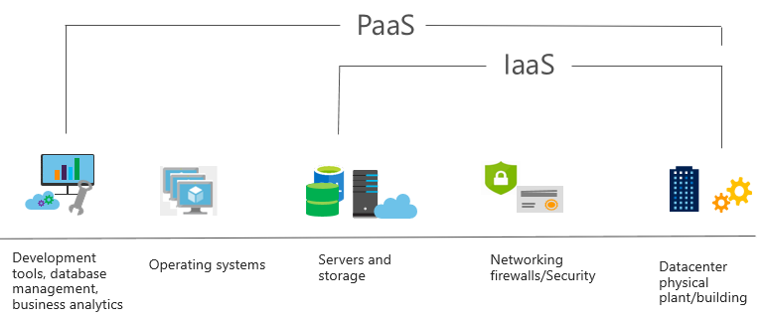
Platform as a Service (PaaS)
Provides environment for building, testing, and deploying software applications.
Helps create applications quickly, without focusing on managing underlying infrastructure.
Notes:
Common usage scenarios:
Development framework. PaaS provides a framework that developers can build upon to develop or customize cloud-based applications. Similar to the way you create a Microsoft Excel macro, PaaS lets developers create applications using built-in software components. Cloud features such as scalability, high-availability, and multi-tenant capability are included, reducing the amount of coding that developers must do.
Analytics or business intelligence. Tools provided as a service with PaaS allow organizations to analyze and mine their data. They can find insights and patterns, and predict outcomes to improve business decisions such as forecasting, product design, and investment returns.
For more information on PaaS, see https://azure.microsoft.com/en-us/overview/what-is-paas/

Slide 22
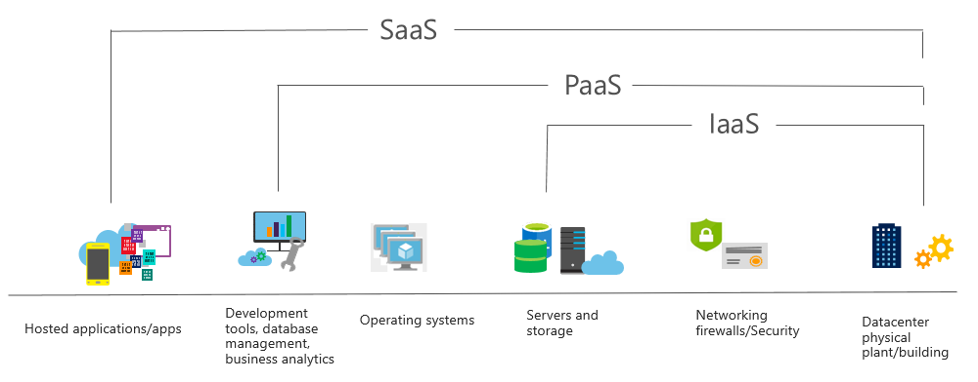
Software as a Service (SaaS)
Centrally hosted and managed software for end users. Users connect to and use cloud-based apps over the internet. For example, Microsoft Office 365, email, and calendars.
Notes:
Common usage scenarios:
Examples of Microsoft SaaS services include Microsoft Office 365, Skype, and Microsoft Dynamics CRM Online.
For more information on SaaS, see https://azure.microsoft.com/en-us/overview/what-is-saas/

Slide 23
Cloud service comparison
IaaS: Flexibility. IaaS is the most flexible cloud service as you have control to configure and manage the hardware running your application.
PaaS: Productivity. Users can focus on application development only, as all platform management is handled by the cloud provider. Working with distributed teams as services is easier, as the platform is accessed over the internet and can be made globally available more easily.
SaaS: Pay-as-you-go pricing model. Users pay for the software they use on a subscription model, typically monthly or yearly, regardless of how much they use the software.
Notes:
The slide contains only some of the cloud service comparison discussion points. Depending on time, you may want to consider broadening out the discussion using some of the points from below.
IaaS
IaaS is the most flexible category of cloud services. It aims to give you complete control over the hardware that runs your application. Instead of buying hardware, with IaaS, you rent it.
IaaS Advantages:
No CapEx. Users have no upfront costs.
Agility. Applications can be made accessible quickly, and deprovisioned whenever needed.
Skills. No deep technical skills are required to deploy, use, and gain the benefits of a public cloud. Organizations can leverage the skills and expertise of the cloud provider to ensure workloads are secure, safe, and highly available.
PaaS
PaaS provides the same benefits and considerations as IaaS, with some additional benefits.
PaaS Advantages:
No CapEx. Users have no upfront costs.
Agility. PaaS is more agile than IaaS, and users do not need to configure servers for running applications.
Productivity. Users can focus on application development only, as all platform management is handled by the cloud provider. Working with distributed teams as services is easier, as the platform is accessed over the internet and can be made globally available more easily.
SaaS
SaaS provides the same benefits as IaaS, but again there some additional benefits.
SaaS Advantages:
No CapEx. Users don’t have any upfront costs.
Agility. Users can provide staff with access to the latest software quickly and easily.
Pay-as-you-go pricing model: Users pay for the software they use on a subscription model, typically monthly or yearly, regardless of how much they use the software.

Slide 24
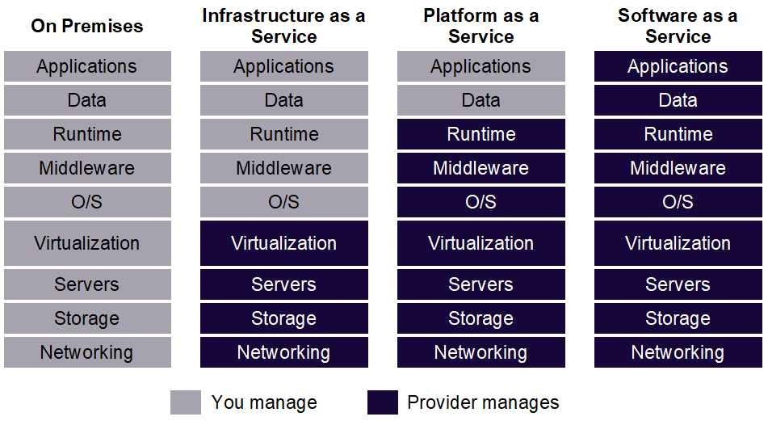
Management responsibilities
Notes:
It is important that users understand what they are responsible for when using cloud services, to ensure their workloads are managed correctly and don't suffer any down time.
IaaS requires the most user management of all the cloud services. The user is responsible for managing the operating systems, data, and applications.
PaaS requires less user management. The cloud provider manages the operating systems, and the user is responsible for the applications and data they run and store.
SaaS requires the least amount of management. The cloud provider is responsible for managing everything, and the end user just uses the software
There is a shared responsibility model for ensuring cloud workloads are run securely and in a well-managed way. Depending on the service you are using, the cloud provider is responsible for some aspects of the workload management, and the customer or end user is responsible for other aspects of the workload management, and in some cases both share a responsibility.

Slide 25
Module 02: Core Azure services

Slide 26
Core Azure architectural components

Slide 27
Regions
Azure is made up of datacenters located around the globe. These datacenters are organized and made available to end users by country/region
In reference to datacenters, a region is a geographical area on the planet containing at least one—but potentially multiple —datacenters that are in close proximity and networked together with a low-latency network
Notes:
A list of regions and their locations is available at https://azure.microsoft.com/en-us/global-infrastructure/locations/
In the context of this course, this is what we mean by "region”.
Microsoft Azure has more global regions than any other cloud provider. This provides customers the flexibility and scale needed to bring applications closer to users around the world, preserving data residency and offering comprehensive compliance and resiliency options for customer. At the time of writing this, Azure is generally available in 42 regions around the world, with plans announced for 12 additional regions.
Special Azure regions
Special regions include:
US DoD Central, US Gov Virginia, US Gov Iowa and more in the US. These are physical and logical network-isolated instances of Azure for US government agencies and partners. They are operated by screened US personnel. Includes additional compliance certifications.
China East, China North, and more in China. These regions are available through a unique partnership between Microsoft and 21Vianet, whereby Microsoft does not directly maintain the datacenters.
Germany Central and Germany Northeast. These regions are available through a data trustee model whereby customer data remains in Germany under control of T-Systems, a Deutsche Telekom company.

Slide 28

Regions - continued
Azure special regions
For applications with specific compliance or legal requirements.
Azure Government (North America)
Azure China 21Vianet
Azure Germany
Region pairs
Each Azure region is paired with another region, within the same geography. Pairing replicates Azure resources to minimize service interruptions from natural disasters, power or network outages.
Notes:
Special Azure regions include:
North America - US DoD Central, US Gov Virginia, US Gov Iowa, and more in the US. These are physical and logical network-isolated instances of Azure for US government agencies and partners. They are operated by screened US personnel, and require strict compliance certifications.
Asia - China East, China North, and more in China. These regions are available through a unique partnership between Microsoft and 21 Vianet. Microsoft does not directly maintain these data centers.
Europe - Germany Central and Germany Northeast. These regions are available through a data trustee model. Customer data remains in Germany, under control of T-Systems (a Deutsche Telekom company).
Additional advantages of region pairs include:
In the event of a wider Azure outage, one region out of every pair is prioritized to help reduce the time it takes to restore them for applications.
Planned Azure updates are rolled out to paired regions one region at a time to minimize downtime and risk of application outage.
Data continues to reside within the same geography as its pair (except for Brazil South) for tax and law enforcement jurisdiction purposes.
Examples of region pairs would be West US paired with East US, and Southeast Asia paired with East Asia.
Note: A full list of region pairs is available at https://docs.microsoft.com/en-us/azure/best-practices-availability-paired-regions#what-are-paired-regions

Slide 29
Geographies
Discrete markets that preserve data residency and compliance boundaries.
Geography features:
Typically contain two or more regions.
Allow customers with specific data-residency and compliance needs to keep their data and applications in close proximity.
Categorized as Americas, Europe, Asia Pacific, Middle East, and Africa.
Notes:
A list of geography locations is available at : https://azure.microsoft.com/en-us/global-infrastructure/geographies/

Slide 30
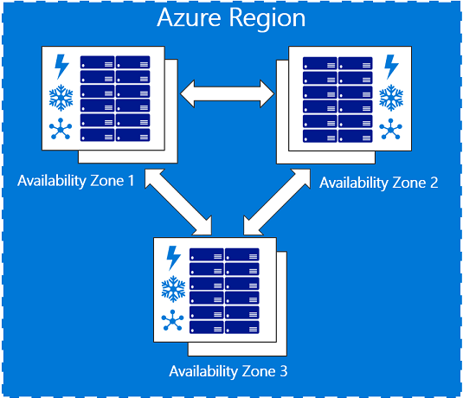
Availability zones
Physically separate locations within an Azure region.
Made up of one or more datacenters, equipped with independent power, cooling, and networking.
Act as an isolation boundary.
If one availability zone goes down, the other continues working.
Notes:
The availability zones are typically connected to each other through very fast, private fiberoptic networks.
Availability zones allow customers to run mission-critical applications with high availability and low-latency replication.
Availability zones are offered as a service within Azure, and to ensure resiliency, there’s a minimum of three separate zones in all enabled regions.
More details about Availability Zones in Azure are available at https://docs.microsoft.com/en-us/azure/availability-zones/az-overview

Slide 31
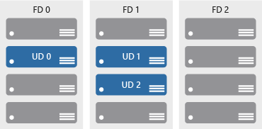
Availability sets
Keep applications online during maintenance or hardware failure.
Comprised of:
Update domains (UD): Scheduled maintenance, performance or security updates are sequenced through update domains.
Fault domains (FD): Provide a physical separation of workloads across different hardware in a data center.

Slide 32
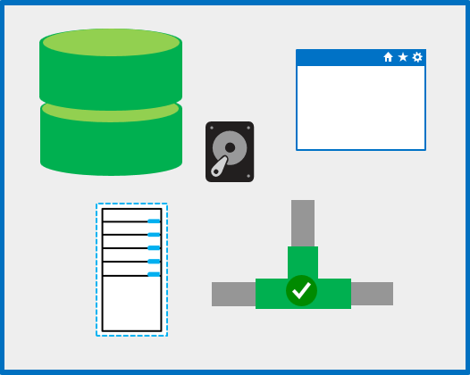
Resource groups
A unit of management for resources in Azure.
Resource group features:
Act as containers to aggregate the resources required by an application into a single, manageable unit.
Every Azure resource must exist in one (and only one) Resource Group.
Notes:
Think of a resource group as a container that allows you to aggregate and manage all the resources required by your application, in a single manageable unit.
Every resource created in Azure must exist in one and only one Resource Group.

Slide 33
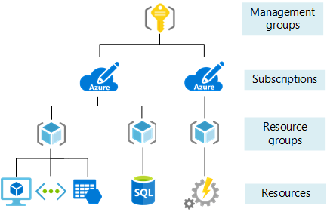
Azure Resource Manager
Provides a management layer in which resource groups and all the resources within it are created, configured, managed, and deleted
With Azure Resource Manager, you can:
Create, configure, manage and delete resources and resource groups
Organize resources
Control access and resources
Automate using different tools and SDKs
Notes:
Azure Resource Manager, provides a consistent management layer that allows you to automate deployment and configuration of resources using different automation and scripting tools, such as Microsoft Azure PowerShell, Azure Command-Line Interface (Azure CLI), Azure portal, REST API, and client software development kits (SDKs).
You can view more details about Azure Resource Manager at https://docs.microsoft.com/en-us/azure/azure-resource-manager/resource-group-overview

Slide 34
Core Azure services and products

Slide 35
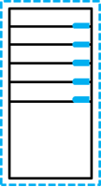
Azure compute services
On-demand computing service for running cloud-based applications.
Azure compute services features:
provides computing resources such as disks, processors, memory, networking, and operating systems.
makes resources available in minutes or seconds.
pay-per-use.
common on-demand Azure services are : (a) Virtual Machines, and (b) Containers.
Notes:
For a full list of compute services available with Azure and the context on when to use them, visit https://azure.microsoft.com/en-us/product-categories/compute/

Slide 36

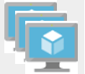
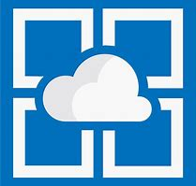

Azure compute services - virtual machine services
VMs are software emulations of physical computers. Examples of Azure services for virtual machines include:
Azure VMs: Infrastructure as a service (IaaS) to create and use VMs in the cloud
VM scale sets: Designed for automatic scaling of identical VMs
App services: Platform as a service (PaaS) offering to build, deploy, and scale enterprise-grade web, mobile, and API apps
Functions: Creates infrastructure based on an event
Notes:
Azure VMs
Azure virtual machines (VMs) let you create and use virtual machines in the cloud. It provides infrastructure as a service (IaaS) and can be used in a variety of different ways. When you need total control over an operating system and environment, Azure VMs are an ideal choice. See https://azure.microsoft.com/en-us/services/virtual-machines/ for more details.
VM scale sets
VM scale sets are an Azure compute resource that you can use to deploy and manage a set of identical VMs. With all VMs configured the same, VM scale sets are designed to support true auto-scale—no pre-provisioning of VMs is required.. See https://azure.microsoft.com/en-us/services/virtual-machine-scale-sets/for more details.
App Services
With App Services, you can quickly build, deploy, and scale enterprise-grade web, mobile, and API apps running on any platform. You can meet rigorous performance, scalability, security and compliance requirements while using a fully managed platform to perform infrastructure maintenance. App Services is a platform as a service (PaaS) offering. See https://azure.microsoft.com/en-us/services/app-service/ for more details.
Functions
When you're concerned only about the code running your service and not the underlying platform or infrastructure, Azure Functions are ideal. They're commonly used when you need to perform work in response to an event (often via a REST request), timer, or message from another Azure service, and when that work can be completed quickly, within seconds or less. See https://azure.microsoft.com/en-us/services/functions/ for more details.

Slide 37
Demo: Create an Azure virtual machine

Slide 38
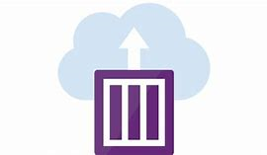
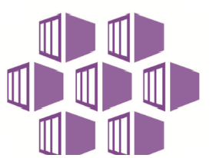
Azure compute services – container services
Containers are a virtualization environment. However, unlike virtual machines, they do not include an operating system. Containers are meant to be lightweight, and are designed to be created, scaled out, and stopped dynamically. Examples of Azure services for containers include:
Azure Container Instances: A PaaS offering that allows you to upload your containers, which it then will run for you
Azure Kubernetes Service: A container orchestrator service for managing large numbers of containers
Notes:
Azure Container Instances
Azure Container Instances offers the fastest and simplest way to run a container in Azure without having to manage any virtual machines or adopt any additional services. It’s a PaaS offering that allows you to upload your containers, which it will run for you. See https://azure.microsoft.com/en-us/services/container-instances/for more details.
Azure Kubernetes Service
The task of automating and managing a large number of containers and how they interact is known as orchestration. Azure Kubernetes Service (AKS) is a complete orchestration service for containers with distributed architectures and large volumes of containers. See https://azure.microsoft.com/en-us/services/kubernetes-service/ for more details.

Slide 39
Demo: Deploy Azure Container Instances (ACI) in Azure Portal.

Slide 40





Azure network services
Networking on Azure allows you to connect cloud and on-premises infrastructure and services.
Azure Virtual Network: An IaaS service to create and use VMs in the cloud
Azure Load Balancer: Designed for automatic scaling of identical VMs
VPN Gateway: A PaaS offering to build, deploy, and scale enterprise-grade web, mobile, and API apps
Azure Application Gateway: Creates infrastructure based on an event
Content Delivery Network: Creates infrastructure based on an event
Notes:
Azure Virtual Network
Azure Virtual Network enables many types of Azure resources such as Azure VMs to securely communicate with each other, the internet, and on-premises networks. A virtual network is scoped to a single region; however, multiple virtual networks from different regions can be connected together using virtual network peering. See https://azure.microsoft.com/en-us/services/virtual-network/ for more details.
Azure Load Balancer
Azure Load Balancer can provide scale for your applications and create high availability for your services.. See https://azure.microsoft.com/en-us/services/load-balancer/ for more details.
VPN gateway
A VPN gateway (also referred to as a virtual network gateway) is a more specific type of virtual network gateway that sends encrypted traffic between an Azure Virtual Network and an on-premises location over the public internet. It provides a more secure connection from on-premises to Azure over the internet. See https://azure.microsoft.com/en-us/services/vpn-gateway/for more details.
Azure Application Gateway
Azure Application Gateway is a web traffic load balancer that enables you to manage traffic to your web applications. It is the connection through which users connect to your application.. See https://azure.microsoft.com/en-us/services/application-gateway/ for more details.
Content Delivery Network
A content delivery network (CDN) is a distributed network of servers that can efficiently deliver web content to users. It is a way to get content to users in their local region to minimize latency. CDN can be hosted in Azure or any other location. See https://azure.microsoft.com/en-us/services/cdn/ for more details.
For a full list of networking services available with Azure, and context on when you use them, see https://azure.microsoft.com/en-us/product-categories/networking/

Slide 41
Azure storage services – data categories
Structured data | Semi-structured data | Unstructured data
Adhere to a schema, with same data fields or properties. | Ad hoc schema. Less organized fields and properties than structured data. | No designated schema or data structure.
Storable in relational database tables, with rows and columns. | Non-relational or NoSQL data, not storable in tables, rows and columns. | Non-relational or blob data, with no restrictions on kinds of data blobs contain.
Examples include, sensor or financial data. | Books, blogs, and HTML documents are examples of semi-structured data. | For example, a blob can hold a PDF, JPG, JSON object, or video.
Notes:
This slide intends to:
help students understand how data are structured and classified
explain why different storage services exist
illustrate how storage services are used
map data structures to corresponding storage services

Slide 42


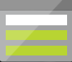
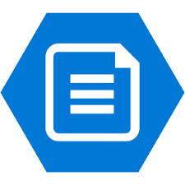
Azure storage services – Azure services
Azure Storage is a service that you can use to store files, messages, tables, and other types of information.
Blob storage: No restrictions on the kinds of data it can hold. Blobs are highly scalable
Disk storage: Provides disks for virtual machines, applications, and other services
File storage: Azure Files offers fully-managed file shares in the cloud
Archive storage: Storage facility for data that is rarely accessed
Notes:
Blob Storage
Azure Blob Storage is unstructured, meaning that there are no restrictions on the kinds of data it can hold. Blobs are highly scalable and apps work with blobs in much the same way as they would work with files on a disk, such as reading and writing data. Blob Storage can manage thousands of simultaneous uploads, massive amounts of video data, constantly growing log files, and can be reached from anywhere with an internet connection.
See https://azure.microsoft.com/en-us/services/storage/blobs/ for more details.
Disk storage
Disk storage provides disks for virtual machines, applications, and other services to access and use as they need, similar to how they would in on-premises scenarios. Details on pricing are available on the Managed Disks pricing page. See https://azure.microsoft.com/en-us/services/storage/disks/ for more general details.
File storage
Azure Files offers fully managed file shares in the cloud that are accessible via the industry standard Server Message Block (SMB) protocol. See https://azure.microsoft.com/en-us/services/storage/files/ for more details.
Archive storage
Archive storage provides a storage facility for data that is rarely accessed. It allows you to archive legacy data at low cost to what it would traditionally have cost to create and maintain archives. See https://azure.microsoft.com/en-us/services/storage/archive/ for more details.

Slide 43

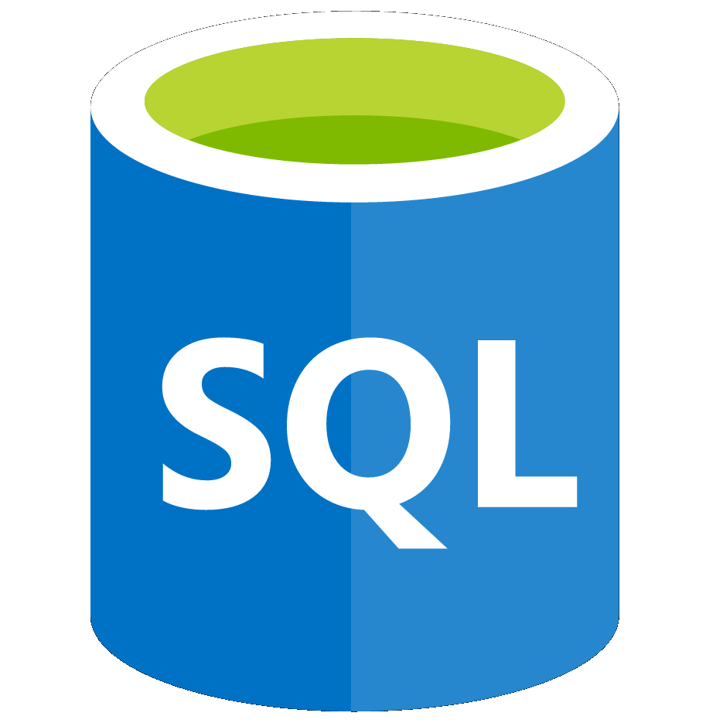
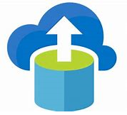
Azure database services
Azure database services are fully-managed PaaS database services that free up valuable time you’d otherwise spend managing your database
Azure Cosmos DB: A globally-distributed database service that enables you to elastically and independently scale throughput and storage
Azure SQL Database: A relational database as a service (DaaS) based on the latest stable version of the Microsoft SQL Server database engine
Azure Database Migration: A fully-managed service designed to enable seamless migrations from multiple database sources to Azure data platforms with minimal downtime
Notes:
Azure Cosmos DB
Azure Cosmos DB is a globally distributed database service that enables you to elastically and independently scale throughput and storage across any number of Azure's geographic regions. See https://azure.microsoft.com/en-us/services/cosmos-db/ for more details.
Azure SQL Database
Azure SQL Database is a relational database as a service (DaaS) based on the latest stable version of the Microsoft SQL Server database engine. SQL Database is a high-performance, reliable, fully managed and secure database. See https://azure.microsoft.com/en-us/services/sql-database/ for more details.
Azure Database Migration Service
The Azure Database Migration Service is a fully managed service designed to enable seamless migrations from multiple database sources to Azure data platforms with minimal downtime (online migrations). See https://azure.microsoft.com/en-us/services/database-migration/ for more details.
For a full list of data services available with Azure, and context on when you use them, see https://azure.microsoft.com/en-us/product-categories/databases/

Slide 44
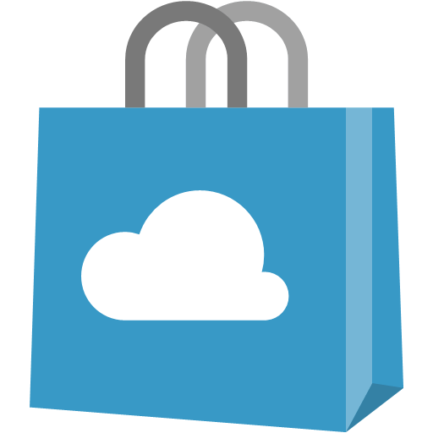
Azure Marketplace
Connects end users with Microsoft partners, Independent Software Vendors (ISVs), and start-ups that offer solutions and services for Azure.
Azure customers, IT professionals and cloud developers can find, try, purchase, and provision Azure applications and services from certified service providers.
Includes close to 10,000 product listings.
Notes:
There is also a Marketplace FAQ available at https://azure.microsoft.com/en-us/marketplace/faq/
You should go to the Azure Marketplace at Azure Marketplace services online at https://azuremarketplace.microsoft.com/en-us/ or also access via the Azure Portal

Slide 45
Azure solutions

Slide 46


Internet of Things
The internet allows any item that's online-capable to access valuable information. This ability for devices to garner and then relay information for data analysis is referred to as the Internet of Things (IoT)
Microsoft IoT Central: A fully-managed global IoT software as a service (SaaS) solution that makes it easy to connect, monitor, and manage your IoT assets at scale
Azure IoT Hub: A managed service hosted in the cloud that acts as a central message hub for bidirectional communication between your IoT application and the devices it manages
Notes:
IoT Central
Microsoft IoT Central is a fully managed global Internet of Things (IoT) software as a service (SaaS) solution that makes it easy to connect, monitor, and manage your IoT assets at scale. No cloud expertise is required to use IoT Central. As a result, you can bring your connected products to market faster while staying focused on your customers. See https://docs.microsoft.com/en-us/azure/iot-central/ for more details.
Azure IoT Hub
Azure IoT Hub is a managed service hosted in the cloud that acts as a central message hub for bi-directional communication between your IoT application and the devices it manages. You can use Azure IoT Hub to build IoT solutions with reliable and secure communications between millions of IoT devices and a cloud-hosted solution backend. You can connect virtually any device to your IoT Hub. https://docs.microsoft.com/en-us/azure/iot-hub/
For a full list of IoT-related services available with Azure, and for context on when you use them, see the page https://azure.microsoft.com/en-us/overview/iot/

Slide 47
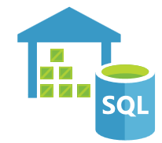


Big data and analytics
Big data refers to large volumes of data that become increasingly hard to make sense of, or consequently make decisions about. Some big data and analytic services in Azure include:
Azure SQL Data Warehouse: A cloud-based Enterprise Data Warehouse that leverages massively parallel processing (mpp) to run complex queries quickly across petabytes of data
Azure HDInsight: A fully-managed, open-source analytics service for enterprises. It is a cloud service that makes it easier, faster, and more cost-effective to process massive amounts of data
Azure Data Lake Analytics: An on-demand analytics job service that simplifies big data. Instead of deploying and tuning hardware, you write queries to transform your data and extract valuable insights.
Notes:
Azure SQL Data Warehouse
Azure SQL Data Warehouse is a cloud-based enterprise data warehouse that leverages massively parallel processing (MPP) to run complex queries quickly across petabytes of data.. See https://azure.microsoft.com/en-us/services/sql-data-warehouse/ for more details.
Azure HDInsight
Azure HDInsight is a fully managed, open-source analytics service for enterprises. It is a cloud service that makes it easier, faster, and more cost-effective to process massive amounts of data. HDInsight allows you run popular open-source frameworks and create cluster types such as Apache Spark, Apache Hadoop, Apache Kafka, Apache HBase, Apache Storm, Machine Learning Services. See https://azure.microsoft.com/en-us/services/hdinsight/ for more general details.
Azure Data Lake Analytics
Azure Data Lake Analytics is an on-demand analytics job service that simplifies big data. Instead of deploying, configuring, and tuning hardware, you write queries to transform your data and extract valuable insights.. See https://azure.microsoft.com/en-us/services/data-lake-analytics/ for more details.
For a full list of Big Data and Analytics services available with Azure, and for context on when you use them, visit https://azure.microsoft.com/en-us/product-categories/analytics/

Slide 48


Artificial Intelligence
Artificial Intelligence (AI), in the context of cloud computing, is based around a broad range of applications, including Machine Learning, which use existing data to forecast future behaviors, outcomes, and trends. Using machine learning, computers learn without being explicitly programmed. Some AI services in Azure include:
Azure Machine Learning service: Provides a cloud-based environment used to develop, train, test, deploy, manage, and track machine learning models
Azure Machine Learning Studio: A collaborative, drag-and-drop visual workspace where you can build, test, and deploy machine learning solutions without needing to write code
Notes:
Azure Machine Learning Service
Azure Machine Learning service provides a cloud-based environment you can use to develop, train, test, deploy, manage, and track machine learning models. Azure Machine Learning service can auto-generate a model and auto-tune it for you. It will let you start training on your local machine, and then scale out to the cloud. When you have the right model, you can easily deploy it in a container such as Docker in Azure. See https://azure.microsoft.com/en-us/services/machine-learning-service/ for more details.
Azure Machine Learning Studio
Azure Machine Learning Studio is a collaborative, drag-and-drop visual workspace where you can build, test, and deploy machine learning solutions without needing to write code. It uses pre-built and pre-configured machine learning algorithms and data-handling modules. Use Machine Learning Studio when you want to experiment with machine learning models quickly and easily, and the built-in machine learning algorithms are sufficient for your solutions. It does not provide as much control over machine learning algorithms as the Machine Learning Service we discussed earlier. See https://azure.microsoft.com/en-us/services/machine-learning-studio/ for more general details.
Note: For a full list of Artificial Intelligence and Machine Learning services available with Azure, see the AI + Machine Learning section on the https://azure.microsoft.com/en-us/overview/ai-platform/ page.

Slide 49

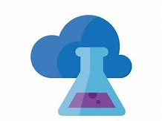
DevOps
DevOps allows you to create build and release pipelines that provide continuous integration, delivery, and deployment for applications.
Azure DevOps services: Provides development collaboration tools including pipelines, Git repositories, Kanban boards, and extensive automated and cloud-based load testing.
Azure DevTest Labs: Allows you to quickly create environments in Azure while minimizing waste and controlling cost
Notes:
Azure DevOps Services
Azure DevOps Services (formerly known as Visual Studio Team Services (VSTS)), provides development collaboration tools including high-performance pipelines, free private Git repositories, configurable Kanban boards, and extensive automated and cloud-based load testing. See https://docs.microsoft.com/en-us/azure/devops/ for more details.
Azure DevTest Labs
Azure DevTest Labs is a service that helps developers and testers quickly create environments in Azure while minimizing waste and controlling cost. Users can test their latest application versions by quickly provisioning Windows and Linux environments using reusable templates and artifacts. See https://azure.microsoft.com/en-us/services/devtest-lab/ for more general details.
Note: For more general details on DevOps services available with Azure, see https://docs.microsoft.com/en-us/azure/#pivot=products&panel=devops

Slide 50
DevOps
DevOps allows you to create build and release pipelines that provide continuous integration, delivery, and deployment for applications.
Azure DevOps services: Provides development collaboration tools including pipelines, Git repositories, Kanban boards, and extensive automated and cloud-based load testing.
Azure DevTest Labs: Allows you to quickly create environments in Azure while minimizing waste and controlling cost
Notes:
Azure DevOps Services
Azure DevOps Services (formerly known as Visual Studio Team Services (VSTS)), provides development collaboration tools including high-performance pipelines, free private Git repositories, configurable Kanban boards, and extensive automated and cloud-based load testing. See https://docs.microsoft.com/en-us/azure/devops/ for more details.
Azure DevTest Labs
Azure DevTest Labs is a service that helps developers and testers quickly create environments in Azure while minimizing waste and controlling cost. Users can test their latest application versions by quickly provisioning Windows and Linux environments using reusable templates and artifacts. See https://azure.microsoft.com/en-us/services/devtest-lab/ for more general details.
Note: For more general details on DevOps services available with Azure, see https://docs.microsoft.com/en-us/azure/#pivot=products&panel=devops

Slide 51
Azure management solutions

Slide 52
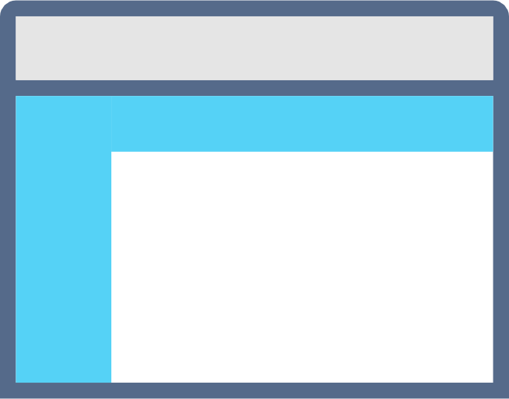
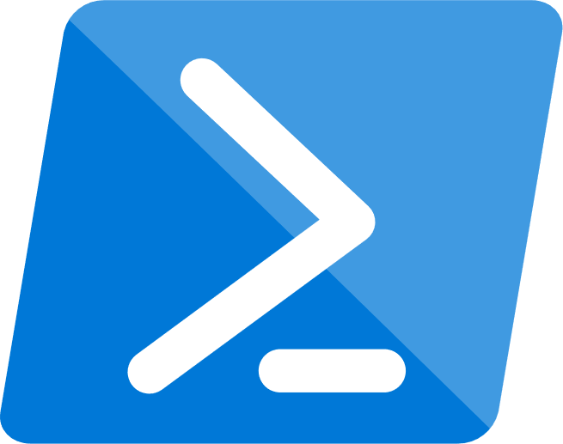
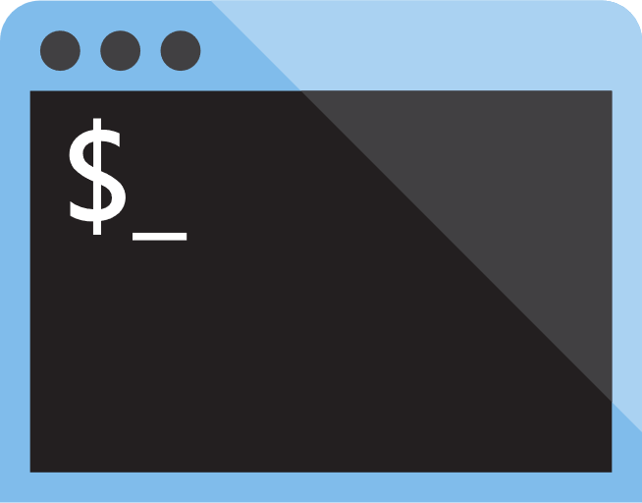

Azure management tools
Configure and manage Azure using a broad range of tools and platforms.
Azure management tools include:
Azure Portal : Management website accessed via a web browser.
Azure PowerShell : Command shell scripting language.
Azure Command-Line Interface (CLI) : Cross-platform, command-line scripting program for Windows, Linux, or MacOS.
Azure Cloud Shell : Browser-based scripting environment.
Notes:
You may provide more detail using the information below. If you’ve time, consider showing students the tools and the URLs for accessing them (where applicable).
Azure Portal - https://portal.azure.com
Azure PowerShell - A module added to Windows PowerShell or PowerShell Core for connecting to your Azure subscription and managing Azure resources.
Azure CLI - A cross-platform, command-line program that connects to Azure and executes administrative commands on Azure resources.
Azure Cloud Shell - A browser-based scripting environment in Azure portal. It provides flexibility by allowing you to choose your preferred shell experience. Linux users can opt for a Bash experience, and Windows users can opt for PowerShell. Access Azure Cloud Shell from : https://shell.azure.com/
You can also use Azure SDKs, in a range of languages, and REST APIs to configure Azure. For a list Azure management tools, see : https://azure.microsoft.com/en-us/downloads/

Slide 53
Module 03: Security, privacy, compliance, and trust

Slide 54
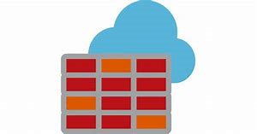
Azure Firewall
Stateful, managed, Firewall as a Service (FaaS) that grants/ denies server access based on originating IP address, to protect network resources.
Azure Firewall features :
applies inbound and outbound traffic filtering rules.
built-in high availability.
unrestricted cloud scalability.
uses Azure Monitor logging.
Notes:
Common Usage Scenarios - You typically deploy Azure Firewall on a central virtual network, to control general network access. With Azure Firewall you can configure:
Application rules that define Fully Qualified Domain Names (FQDNs) which can be accessed from a subnet.
Network rules based on source address, protocol, destination port, and destination address.
Azure Application Gateway also provides a firewall, called the Web Application Firewall (WAF). WAF is different to Azure Firewall. WAF protects your web applications from common exploits and vulnerabilities, whereas Azure Firewall provides:
Inbound protection for non-HTTP/S protocols, such as File Transfer Protocol (FTP) and Secure Shell (SSH).
Outbound network-level protection for all ports and protocols.
Application-level protection for outbound HTTP/S.
The distinct features and functions of Azure Firewall make it suited to different use cases than WAF.
For details, see : https://azure.microsoft.com/en-us/services/azure-firewall/

Slide 55

Azure Distributed Denial of Service (DDoS) protection
DDoS attacks overwhelm and exhaust network resources, making apps slow or unresponsive.
Azure DDoS Protection features :
sanitizes unwanted network traffic, before it impacts service availability.
basic service tier is automatically enabled in Azure.
standard service tier adds mitigation capabilities, tuned to protect Azure Virtual Network resources.
Notes:
Azure DDoS standard protection mitigates against the following attacks:
Volumetric attacks – Aims to flood the network layer with high volumes of seemingly legitimate traffic.
Protocol attacks - Render network targets inaccessible by exploiting weaknesses in the layer 3 and layer 4 protocol stack.
Resource (application) layer attacks - Target web application packets to disrupt the data transmission between hosts.
For details about Azure DDoS Protection, see : https://azure.microsoft.com/en-us/services/ddos-protection/

Slide 56

Network security groups (NSGs)
Filters network traffic to, and from, Azure resources on Azure Virtual Networks.
Network security group features :
set inbound and outbound rules to filter by source and destination IP address, port, and protocol.
add multiple rules, as needed, within subscription limits.
Azure applies default, baseline, security rules to new NSGs.
override default rules with new, higher priority, rules.
Notes:
NSG rules have the following properties:
Name : Unique NSG name.
Priority : A number between 100 and 4096. Rules are processed in order of priority; lower numbers are processed before higher numbers.
Source or Destination : Apply the rule to an individual IP address or IP address range, service tag, or application security group.
Protocol : Specifies a network protocol for the rule (can be TCP, UDP, or Any).
Direction : Applies the rule to either inbound or outbound traffic.
Port Range : Enforces the rule on a specific port or range of ports.
Action : Sets the rule to either allow or deny traffic.
For details about NSG, see : https://docs.microsoft.com/en-us/azure/virtual-network/security-overview#network-security-groups

Slide 57

Application Security Groups
Provides for the grouping of servers with similar port filtering requirements, and group together servers with similar functions, such as web servers
Application security group features :
Allows you to reuse your security policy at scale without manual maintenance of explicit IP addresses
handles the complexity of explicit IP addresses and multiple rule sets, allowing you to focus on your business logic
Notes:
For details about ASG, see : https://docs.microsoft.com/en-us/azure/virtual-network/security-overview#application-security-groups

Slide 58
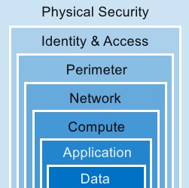
Defense in Depth
A layered approach to securing computer systems.
Provides multiple levels of protection.
Attacks against one layer are isolated from subsequent layers.
Notes:
This is conceptual, to be kept high level, explaining how security options can be targeted at each layer. We will discuss two layers in more depth in the next slide.

Slide 59
Authentication and authorization
Two concepts are fundamental to understanding identity and access.
Authentication
identifies the person or service seeking access to a resource.
requests legitimate access credentials.
basis for creating secure identity and access control principles.
Authorization
determines an authenticated person’s or service’s level of access.
defines which data they can access, and what they can do with it.
Notes:
Note : Authentication is sometimes shortened to AuthN, and authorization is sometimes shortened to AuthZ.

Slide 60

Azure Active Directory (AD)
Microsoft Azure’s cloud-based identity and access management service.
Services provided by Azure AD include :
authentication (employees sign-in to access resources)
single sign-on (SSO)
application management
Business to Business (B2B) and Business to Customer (B2C) identity services
Notes:
Examples of Azure AD services:
Authentication – Adds functionalities such as: self-service user-password reset; multi-factor authentication (MFA); customized banned password lists; smart lockout services.
Single-Sign-On (SSO) - Users only need one ID and password to access multiple applications.
Application management - Manage cloud and on-premises apps using Azure AD’s Application Proxy, SSO, SaaS apps, and My Apps portal (also referred to as Access panel).
Business to Business (B2B) identity services - Manage user credentials for guests and external partners, while retaining control over internal user accounts.
Business to Customer (B2C) identity services – Add services that allow you to customize and control how users of your application sign up, sign in, and manage their user profiles. Includes integrated social identity, sign in experiences.
For details about Azure AD, see : https://azure.microsoft.com/en-us/services/active-directory/

Slide 61

Azure Security Center
A monitoring service that provides threat protection across all your Azure, and on-premises, services.
Azure Security Center features :
provides security recommendations based on your configurations, resources, and networks.
monitors security settings across your on-premises and cloud workloads.
automatically applies your security policies to any new services you provision.
Notes:
Azure Security Center is part of the Center for Internet Security’s (CIS) benchmark recommendations : https://www.cisecurity.org/cis-benchmarks/
Azure Security Center versions
Azure Security Center is available in Free and Standard tiers:
Free tier - Available as part of your Azure subscription, this tier is limited to assessments and recommendations of Azure resources only.
Standard tier - Provides a full suite of security-related services, including: continuous monitoring, threat detection, just-in-time access control for ports.
To access the full suite of Azure Security Center services, upgrade to a Standard tier subscription. A 60-day free trial is accessible from the Azure Security Center dashboard in Azure Portal.
For details about Azure Security Center, see : https://azure.microsoft.com/en-us/services/security-center/

Slide 62
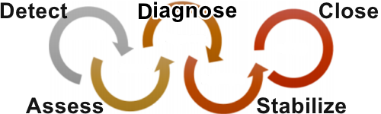
Azure Security Center usage scenarios
You can use Security Center in the Detect, Assess, and Diagnose stages of an incident response.
Use Security Center recommendations to enhance security.
Notes:
You can use Security Center during the detect, assess, and diagnose stages. Here are examples of how Security Center can be useful during the three initial incident response stages:
Detect. Review the first indication of an event investigation. Example: Use the Security Center dashboard to review the initial verification that a high-priority security alert was raised.
Assess. Perform the initial assessment to obtain more information about the suspicious activity. Example: Obtain more information about the security alert.
Diagnose. Conduct a technical investigation and identify containment, mitigation, and workaround strategies. Example: Follow the remediation steps described by Security Center in that particular security alert.
2. Another usage example is to Use Security Center recommendations to enhance security.
You can reduce the chances of a significant security event by configuring a security policy, and then implementing the recommendations provided by Azure Security Center.
A security policy defines the set of controls that are recommended for resources within that specified subscription or resource group. In Security Center, you define policies according to your company's security requirements.
Security Center analyzes the security state of your Azure resources. When Security Center identifies potential security vulnerabilities, it creates recommendations based on the controls set in the security policy. The recommendations guide you through the process of configuring the needed security controls. For example, if you have workloads that do not require the Azure SQL Database Transparent Data Encryption (TDE) policy, turn off the policy at the subscription level and enable it only in the resources groups where SQL TDE is required.
You can read more about Azure Security Center at https://azure.microsoft.com/en-us/services/security-center/

Slide 63

Azure Key Vault
Stores application secrets in a centralized cloud location, to securely control access permissions, and access logging.
Use Azure Key Vault for :
secrets management.
key management.
certificate management.
storing secrets backed by hardware security modules (HSMs).
Notes:
The benefits to using Azure Key Vault include:
Centralized application secrets - Centralizing storage for application secrets allows you to control their distribution, and reduces the chances that secrets may be leaked accidentally.
Securely stored secrets and keys - Azure uses industry-standard encryption algorithms, key lengths, and HSMs. Proper authentication and authorization is required to access secrets and key.
Monitor access and use – With Azure Key Vault, you can monitor and control access to company secrets.
Simplified administration of application secrets - Enroll and renew certificates from public certificate authorities (CAs). Scale up and replicate content within regions. Manage application secrets with standard management tools.
Integrate with other Azure services - Integrate Azure Key Vault with storage accounts, container registries, event hubs, and many other Azure services.
For details about Azure Key Vault, see : https://azure.microsoft.com/en-us/services/key-vault/ webpage.

Slide 64

Azure Monitor
Collect, analyze, and act on telemetry from cloud and on-premises environments, to maximize your applications’ availability and performance.
starts collecting data as soon as you create an Azure subscription and add resources.
Activity Logs record all resource creation and modification events.
Metrics measure resource performance and consumption.
add an Azure monitor agent to collect operational data for a resource.
Notes:
What data does Azure Monitor collect? - Azure Monitor collects data from many sources. The types of data collected by Azure Monitor include (not a full list) :
Application monitoring data : Data about the performance and functionality of the code you have written, regardless of its platform.
Azure resource monitoring data : Data about the operation of an Azure resource.
Azure subscription monitoring data : Data about the operation and management of an Azure subscription, as well as data about the overall health and operation of Azure itself.
Diagnostic settings - As soon as you create an Azure subscription and start adding resources, such as virtual machines and web apps, Azure Monitor starts collecting data.
Activity Logs record when resources are created or modified.
Metrics tell you how a resource is performing, and how much the resource is consuming (for example, network bandwidth consumption, etc.).
You can extend the data you're collecting into the actual operation of a resource. Do this by enabling diagnostics, and adding a monitoring agent to the resource.
For details about Azure Monitor, see : https://azure.microsoft.com/en-us/services/monitor/

Slide 65

Azure service health
Evaluate the impact of Azure service issues with personalized guidance and support, notifications, and issue resolution updates.
Components of Azure service health :
Azure Status : provides a global overview Azure services’ state of health.
Service Health : customizable dashboard for tracking the state of services in the regions you use.
Azure Resource Health : diagnose and obtain support for Azure service issues affecting your resources.
Notes:
Together, these components provide comprehensive insights into Azure’s state of health. You can choose the level of granularity that is most relevant to your requirements.
For details about Azure Service Health, see : https://azure.microsoft.com/en-us/services/monitor/

Slide 66
Module 04: Azure pricing and support

Slide 67
Azure subscriptions

Slide 68
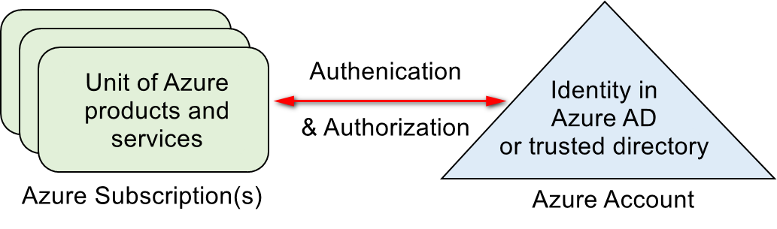
Azure subscriptions
An Azure subscription provides you with authenticated and authorized access to Azure products and services and allows you to provision resources on Azure. It is a logical unit of Azure services that links to an Azure account.
Azure offers free and paid subscription options to suit different needs and requirements. An account can have one subscription or multiple subscriptions that have different billing models, and to which you apply different access-management policies.

Slide 69
Subscription uses and options
You can use Azure subscriptions to define boundaries around Azure products, services, and resources.
Two types of subscription boundaries that you can use:
Billing boundary. This subscription type determines how an Azure account is billed for using Azure. You can create multiple subscriptions for different types of billing requirements.
Access control boundary. Azure will apply access management policies at the subscription level, and you can create separate subscriptions to reflect different organizational structures.
Several other subscription types to choose from include the Free account and Pay-As-You-Go.
Notes:
You can select from a range of Azure subscription options, including:
A free subscription. This subscription is for 30 days and includes a $200 credit. This allows you unlimited access to the free Azure products and then a limit of $200 to spend on the paid products. Your Azure services are disabled when the trial ends or when your credit expires for paid products, unless you upgrade to a paid subscription.
Pay-As-You-Go subscription. This subscription allows you to pay for what you use by attaching a credit or debit card to your account. Organizations can apply to Microsoft for invoicing privileges.
Member offers. Your existing membership to certain Microsoft products and services affords you credits for your Azure account and reduced rates on Azure services. For example, member offers are available to Microsoft Visual Studio subscribers, Microsoft Partner Network members, Microsoft BizSpark members, and Microsoft Imagine members.
You could also menti that there are subscription service limits, as per here https://docs.microsoft.com/en-us/azure/azure-subscription-service-limits
For more information on Azure subscription offers, refer to https://azure.microsoft.com/en-us/support/legal/offer-details/

Slide 70
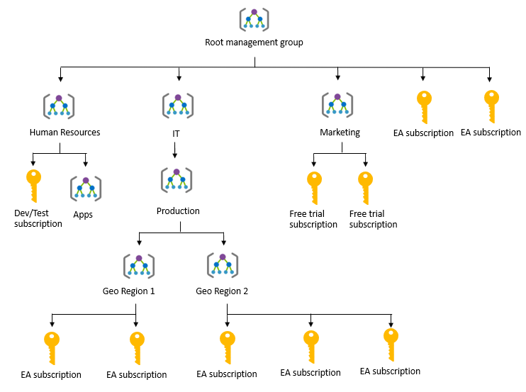
Management groups
Azure Management groups are containers for managing access, policies, and compliance across multiple Azure subscriptions
Management groups allow you to order your Azure resources hierarchically into collections, which provide a further level of classification beyond subscriptions.
Notes:
You can manage your Azure subscriptions more effectively by using Azure Policy and Azure role-based access controls (RBACs). These provide distinct governance conditions that you can apply to each management group. The resources and subscriptions you assign to a management group automatically inherit the conditions that you apply to that management group.
You can point out the presence of management groups for Human resources, IT with sub management groups for Production and then for different geographies, there is also one for Marketing. These are helping divide up and make the usage more manageable.
For more information about management groups, refer to:
https://docs.microsoft.com/en-us/azure/governance/management-groups/

Slide 71
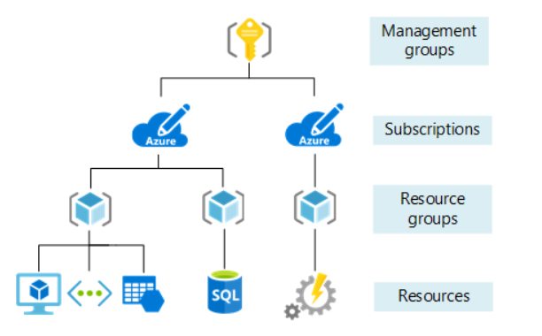
Object Hierarchy
The organizing structure for resources in Azure has four levels:
Notes:
- Management groups: These are containers that help you manage access, policy, and compliance for multiple subscriptions. All subscriptions in a management group automatically inherit the conditions applied to the management group.
- Subscriptions: A subscription groups together user accounts and the resources that have been created by those user accounts. For each subscription, there are limits or quotas on the amount of resources you can create and use. Organizations can use subscriptions to manage costs and the resources that are created by users, teams, or projects.
- Resource groups: A resource group is a logical container into which Azure resources like web apps, databases, and storage accounts are deployed and managed.
- Resources: Resources are instances of services that you create, like virtual machines, storage, or SQL databases

Slide 72
Planning and managing costs

Slide 73
Purchasing Azure products and services
Three main customer types on which the available purchasing options for Azure products and services are contingent are:
Enterprise: Enterprise customers sign an Enterprise Agreement with Azure that commits them to spending a negotiated amount on Azure services, which they typically pay annually.
Web direct: Web direct customers sign up for Azure through the Azure website.
Cloud solution providers (CSPs): Typically are Microsoft partner companies that a customer hires to build solutions on top of Azure. Payment and billing for Azure usage occurs through the customer's CSP.
Products and services in Azure are arranged by category, such as compute and networking, which have various resources that you can provision.
Notes:
Products and services in Azure are arranged by category, which have various resources that you can provision. You select the Azure products and services that fit your requirements, and your account is billed according to Azure's pay-for-what-you-use model.
Usage meters
When you provision an Azure resource, Azure creates one or more meter instances for that resource. The meters track the resources' usage, and each meter generates a usage record that is used to calculate your bill.
For example, a single virtual machine that you provision in Azure might have the following meters tracking its usage:
Compute Hours
IP Address Hours
Data Transfer In
Data Transfer Out
And more
For more information about purchasing Azure products and services, refer to https://azure.microsoft.com/en-us/pricing/purchase-options/

Slide 74
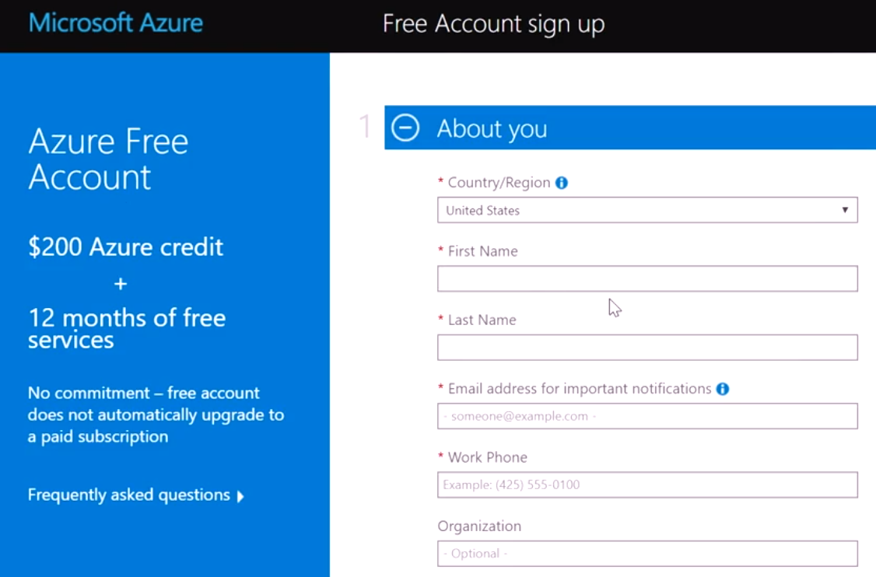
Azure free account
An Azure free account provides subscribers with a $200 USD Azure credit that they can use for paid Azure products during a 30-day trial period.
Once you use that $200 USD credit or reach your trial's end, Azure suspends your account unless you sign up for a paid account.
Notes:
If you upgrade to a Pay-As-You-Go subscription within the 30-day trial period, by providing your credit or debit card details you can use a limited selection of free services for 12 months. After 12 months, you will be billed for the services and products in use on your account at the pay-as-you-go rate.
For more information about Azure free accounts, refer to https://azure.microsoft.com/en-us/free/

Slide 75
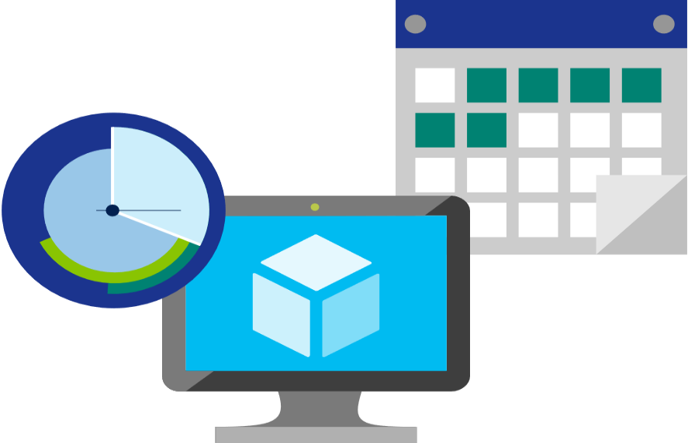
Factors affecting costs
There are three primary factors affect costs:
Resource Type: Costs are resource-specific, so the usage that a meter tracks and the number of meters associated with a resource depend on the resource type.
Services: Azure usage rates and billing periods can differ between Enterprise, Web Direct, and CSP customers.
Location: The Azure infrastructure is globally distributed, and usage costs might vary between locations that offer particular Azure products, services, and resources.
Notes:
For more information about Azure usage charges, refer to https://docs.microsoft.com/en-us/azure/billing/billing-understand-your-invoice

Slide 76

Zones for Billing Purposes
Bandwidth refers to data moving in and out of Azure datacenters. Some inbound data transfers are free, such as data going into Azure datacenters. For outbound data transfers—such as data going out of Azure datacenters—pricing is based on Zones.
A zone is a geographical grouping of Azure Regions for billing purposes. Zones are:
Zone 1. Includes West US, East US, West Europe, and others.
Zone 2 . Includes Australia Central, Japan West, Central India, and others.
Zone 3. Includes Brazil South only.
DE Zone 1. Includes Germany Central and Germany Northeast.
Notes:
Point out that the Zone referred to here, is different from Availability Zone. Availability Zones being an Azure service providing High availability, whereas Zones in the context of billing are geographical entities, used for data transfer pricing between defined geographical areas called Zones.
Zone is a geographical grouping of Azure Regions for billing purpose. Data transfer pricing is based on the Zones.

Slide 77
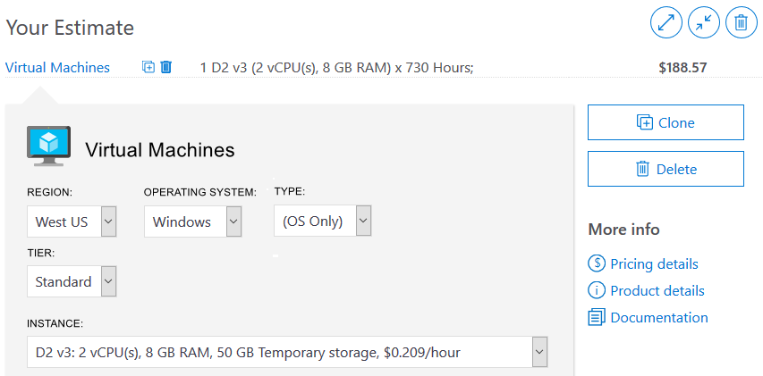
Pricing calculator
Helps you estimate the you need and configure them according to your specific requirements
Azure provides a detailed estimate of the costs associated with your selections and configurations
Notes:
You might want to demonstrate the Pricing calculator at https://azure.microsoft.com/en-us/pricing/calculator/
Note: The pricing calculator provides estimates, and not actual price quotes. Actual prices can vary depending upon the date of purchase, the payment currency, and the type of Azure customer.
Get a new estimate from the pricing calculator by adding, removing, or reconfiguring selected products. You also can access pricing details, product details, and documentation for each product from the pricing calculator.

Slide 78
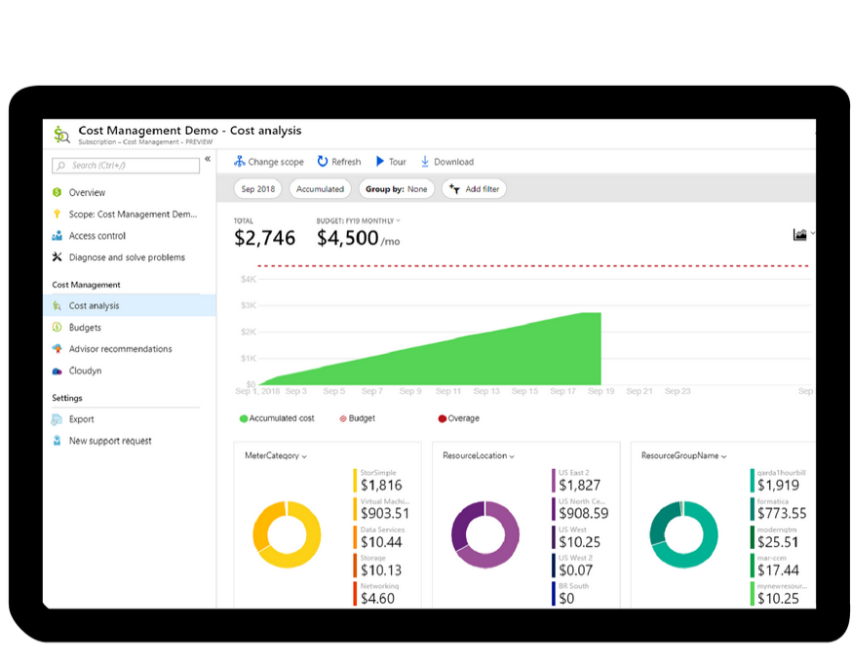
Azure Cost Management
Azure Cost Management is an Azure product that provides a set of tools for monitoring, allocating, and optimizing Azure costs, it provides the following:
Reporting: Generates reports
Data enrichment: Improves accountability by categorizing resources with tags
Budgets: Monitors resource demand trends, consumption rates, and cost patterns
Alerting: Provides alerts based on your cost and usage budgets
Recommendations: Provides recommendations to eliminate idle resources and to optimize provisioned Azure resources
Notes:
Note: For more information about Cost Management, refer to https://azure.microsoft.com/en-us/services/cost-management/

Slide 79





Alternative support channels
Other support channels available outside of the Azure official support plans:
Microsoft Developer Network (MSDN) Azure Forums.
Stack Overflow
Server Fault
Azure Feedback Forums at Microsoft Azure general feedback
Twitter. Tweet @AzureSupport to get answers and support
Notes:
For more information about alternative Azure support channels, refer to https://azure.microsoft.com/en-us/support/community/

Slide 80
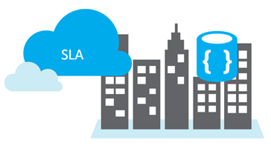
Service Level Agreements (SLAs)
SLAs document the specific terms that define Azure performance standards
SLAs define Microsoft’s commitment to an Azure service or product
Individual SLAs are available for each Azure product and service
SLAs also define what happens if a service or product fails to meet the designated availability commitments

Slide 81
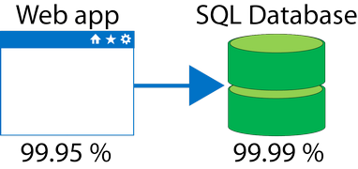
Composite SLAs
At the time of this writing, an App Service web app that writes to Azure SQL Database has the following SLAs:
App Service Web Apps is 99.95 percent
SQL Database is 99.99 percent
Question: What is the maximum downtime you would expect for this application, as across?
Answer: The composite SLA for this application is 99.95% × 99.99% = 99.94%.
This is lower than the individual SLAs. However, you can construct SLAs to improve overall application SLA.

Slide 82
Improving application SLAs
The following table lists the potential cumulative downtime for various SLA levels over different durations
SLA | Downtime per week | Downtime per month | Downtime per year
99% | 1.68 hours | 7.2 hours | 3.65 days
99.9% | 10.1 minutes | 43.2 minutes | 8.76 hours
99.95% | 5 minutes | 21.6 minutes | 4.38 hours
99.99% | 1.01 minutes | 4.32 minutes | 52.56 minutes
99.999% | 6 seconds | 25.9 seconds | 5.26 minutes

